Slide 1


Oracle database
Lecture 8

Slide 2

Today’s Agenda
Introduction To DML Commands
The INSERT Command
Different Types Of INSERT Commands
Introduction To null
The UPDATE Command

Slide 3
DML Commands
DML Commands stand for Data Manipulation Language.
These commands deal with changing the content of the table i.e they deal with table data.
The three popular commands in this category are:
Insert
Update
Delete

Slide 4
DML Commands
Command Name : INSERT
Purpose : The INSERT command is used to insert a new row into the table.
There are multiple syntaxes of INSERT command and they are:
Standard Insert
Inserting into selected columns
Interactive Insert

Slide 5
Syntax Of Standard Insert
Syntax:
Insert into <table_name> values(<list_of_values.);
Points To Remember
No of values must be exactly same as number of columns
All the values should be separated with commas
Order of values must match with the order of columns in the table
The values of type char , varchar2 and date must be enclosed in single quotes
For date values the pattern must be ‘DD-MON-YY’
Make sure to issue the commit command after all the insertion has been done so that the data gets permanently saved in the table.

Slide 6
Example Of Standard Insert
Example:
Suppose we have Students table with 3 columns as s_id ,s_name and dob of data type number(3),varchar2(15) and date respectively
Insert into Students values(101,’Amit’,’15-Jan-96’);
If everything is OK a new row will be created and we will get the acknowledgement from Oracle as 1 row inserted

Slide 7
How Oracle Handles Type Mismatch?
If the data provided by us does not match with the data type of the column then Oracle tries to perform type conversion
This automatic conversion is called implicit conversion, and follows certain rules mentioned in the next slide

Slide 8
Rules Of Implicit Conversion
For number data type column if we pass a number in quotes then too Oracle accepts it and automatically converts it to number . For example , passing ‘15’ for s_id will work.
But if we pass any character or symbol in quotes for a number data type column the Oracle gives INVALID NUMBER error
For varchar2 and char we can pass numbers even without quotes then Oracle will convert it to varchar2 or char.
But if we pass any character or symbol without quotes then Oracle will give error

Slide 9
Selective Insert
Some times , we may not want to insert values in all the columns of the table.
In such cases , if we use the previous version of INSERT command then Oracle will give error.
For example , suppose we don’t know the DOB of a student but we want to insert values for s_id and s_name . Now if we write the INSERT command as :
Insert into Students values(102,’Dinesh’);
Then Oracle will give error message: Not enough values!

Slide 10
Selective Insert
In such cases , Oracle has provided us another syntax of INSERT command called as Selective Insert.
In this we specify the names of columns after the table name in the INSERT command in which we want to insert the values followed by the list of values as before.

Slide 11
Syntax Of Selective Insert
Syntax:
Insert into <table_name>(<list_of_columns>) values(<list_of_values.);
Points To Remember
Column names must be same as present in the table
Column names can appear in any order
Order of values must match with the order of columns given in the INSERT command.
Oracle will automatically insert null , into all those columns for which we have not provided the value

Slide 12
What Is null ?
In the database world, NULL or null , is special.
It is a marker for missing or unknown information.
NULL is special in the sense that it is not a value like a number, character string, or date.
Therefore, we cannot compare it with any other values like zero (0) or an empty string (”).

Slide 13
Example Of Selective Insert
Example:
Insert into Students(s_id,s_name)values(104,’Karan’);
The above command will execute successfully and will insert null as DOB of the student 104.
If everything is OK a new row will be created and we will get the acknowledgement from Oracle as 1 row inserted

Slide 14
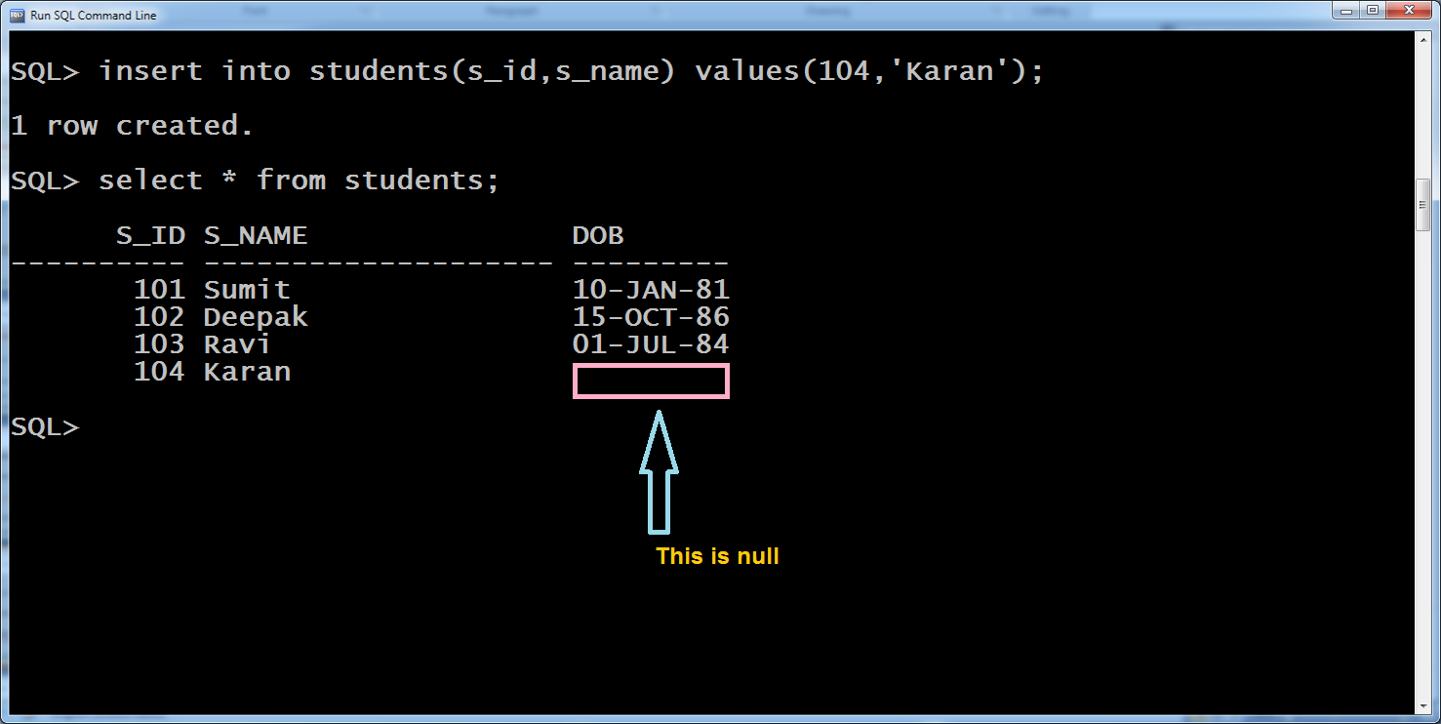
Example Of Selective Insert

Slide 15
Alternate Way
The previous command can also be written using standard INSERT command .
The only thing to remember is that we will have to explicitly provide null as a value for whichever column we don’t want to give the value.
Example:
Insert into Students values(104,’Karan’,null);

Slide 16
Interactive Insert
Oracle allows us to write the INSERT command in such a way that it demands input at run time.
In simple words we can say that just like programming languages have functions for input , similarly, Oracle also has a provision to accept input at runtime.
To do this we use the symbol of & in our INSERT command and this symbol is called as SUBSTITUTOR.
This is because when the command is executed , the value is accepted from the user and it replaces the symbol of &

Slide 17
Syntax Of Interactive Insert
Syntax:
Insert into <table_name>values(&<some_text>,&<some_text>);
Points To Remember
The word <some_text> can be any text we want to show as a message to the user at run time and it should be a single word.
When the command runs , Oracle automatically displays the message:
Enter the value for <some_text>:
And waits for the input.
Then we need to supply the input
These values must be without quotes for number type and in quotes for char, varchar2 and date type.
If we want to skip values then we can either type null or empty quotes like ‘’
The input which we provide ,then replaces &<some_text> in the actual command

Slide 18
Example Of Interactive Insert
Example:
Insert into Students values(&s_id,&s_name,&birthdate);
When the above command runs it will ask for input of s_id , s_name and birthdate
If everything is OK a new row will be created and we will get the acknowledgement from Oracle as 1 row inserted

Slide 19
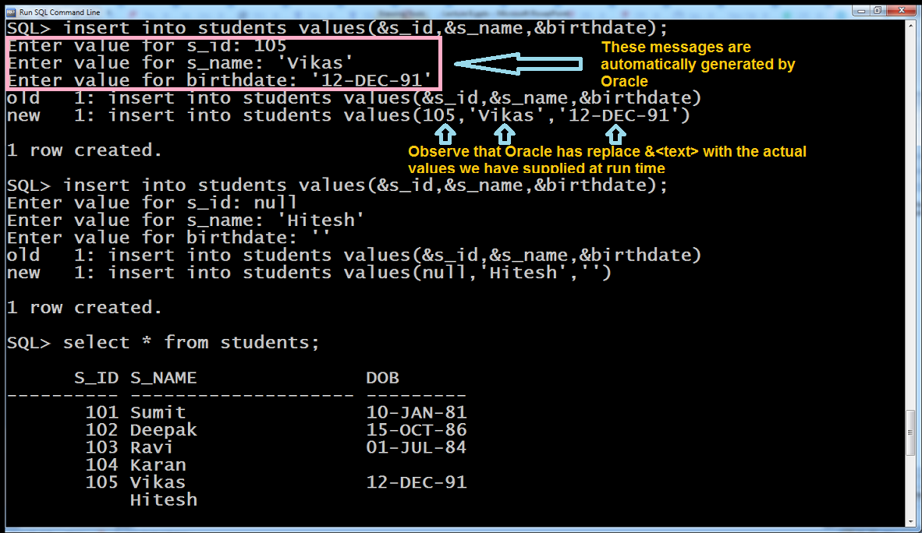
Example Of Interactive Insert

Slide 20
The UPDATE Command
Command Name : UPDATE
Purpose : The UPDATE command is used to update columns of existing rows in the table.
Remember , UPDATE never inserts new data , it only updates existing values of a column.

Slide 21
The Two Versions Of Update
The UPDATE command has 2 versions:
Update ………
Update ………Where <test_cond>
The first version updates the specified column of all the rows
The second version is called SEARCHED UPDATE as it uses the WHERE clause containing a CONDITION and updates the columns of only those rows whose data matches the given condition

Slide 22
Syntax Of First Version
Syntax:
Update <table_name> set <col_name>=<value>,<col_name>=<value>;
Points To Remember
We can update multiple columns in a single update command.
The order of columns might not be same as in the table.
The values given must match with the data type of the column.
If they don’t match then Oracle will try to perform conversion and if it fails to do so then error will arise

Slide 23
Example Of Update
Example:
Suppose we want to increment s_id of every student by 100 , then our command will be:
Update students set s_id=s_id+100;
If everything is OK then Oracle will display no of rows updated.

Slide 24
Syntax Of SEARCHED UPDATE
Syntax:
Update <table_name> set <col_name>=<value>,<col_name>=<value> where <test_cond>;
Points To Remember
We can write conditions using =,>,<.>=,<= and !- operators for normal values.
But for comparing with null we have to use special operators called is and is not.
For varchar2 and char Oracle will perform case sensitive comparison.

Slide 25
Example Of SEARCHED UPDATE
Example:
Suppose we want to change s_name of student whose s_id is 103 to Deepesh , then our command will be
Update students set s_name=‘Deepesh’ where s_id=103;
Suppose we want to change dob of student whose s_name is Sumit to 15-Apr-96 , then our command will be
Update students set dob=‘15-Apr-96’ where s_name=‘Sumit’;

Slide 26
Example Of SEARCHED UPDATE
Example:
Suppose we want to change dob of student to 15-Aug-97 whose dob is null , then our command will be
Update students set dob=‘15-Apr-97’ where dob is null;
Suppose we want to change s_name of student to null whose s_id is 101 , then our command will be
Update students set s_name=null where s_id=101;

